Slide 1
National Medical Website
-- Make u able to see doctors everywhere

Slide 2
Background
Don't Skip classes
"Make Money"
"Live like Song-zhongji"?

Slide 3
TOPICS 2DAY
Doctors want to know patient's history:
http://www.sojump.com/report/8313770.aspx
"Over-check", "Over-Medical"
Latent Help

Slide 4
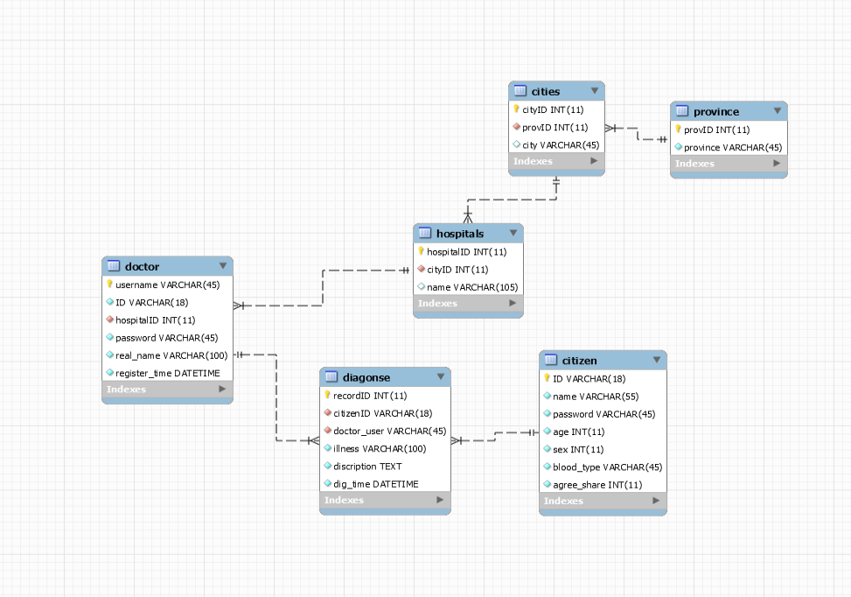
DB DESIGN

Slide 5
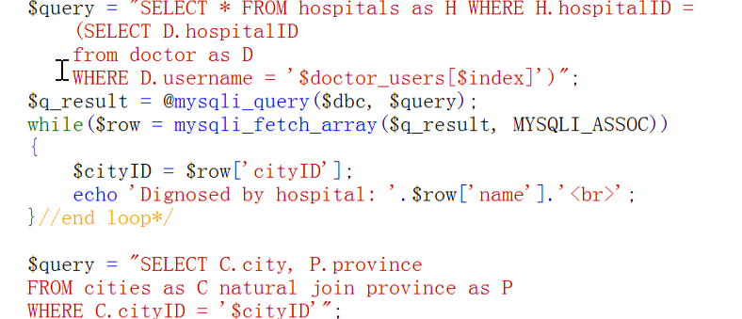
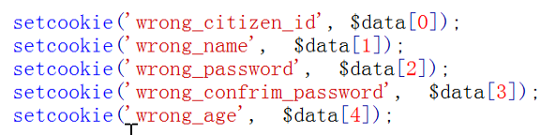
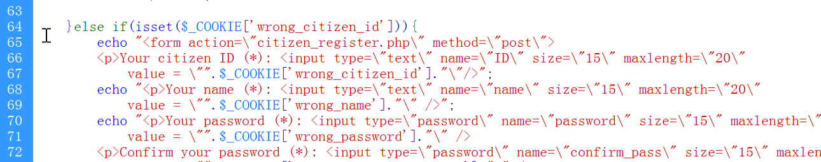
TECHNOLOGY USED
Hidden forms
Multiple Queries
Cookies

Slide 6
Problems
>> Millions of data, billions of data
Do doctors willing to use it?
Do u dare to believe ur fellow from different hospitals?
New problems for patients?
How to make money from this? Data mining??
Safety and integrity?

Slide 7
THANKS

